Slide 1
DOTA2 NEWS APP WITH IONIC2​
PRESENTER: PHAM DUY NGUYEN​
MENTOR: PHAN TICH HOANG​, Vu Anh Tu

Slide 2
CONTENT
Technology​
Overall Architecture​
Usecase Diagram​
Database​
Demo​
Q&A​

Slide 3
App ID On Ionic View & Github
App Store -> Ionic View
App Id: ADA0E256
Github: https://github.com/IceNeoMax/Team-Elite

Slide 4
Technology
Front-end: Ionic 2, Web animation API, Material
Back-end: Ionic Storage, Fire Base

Slide 5
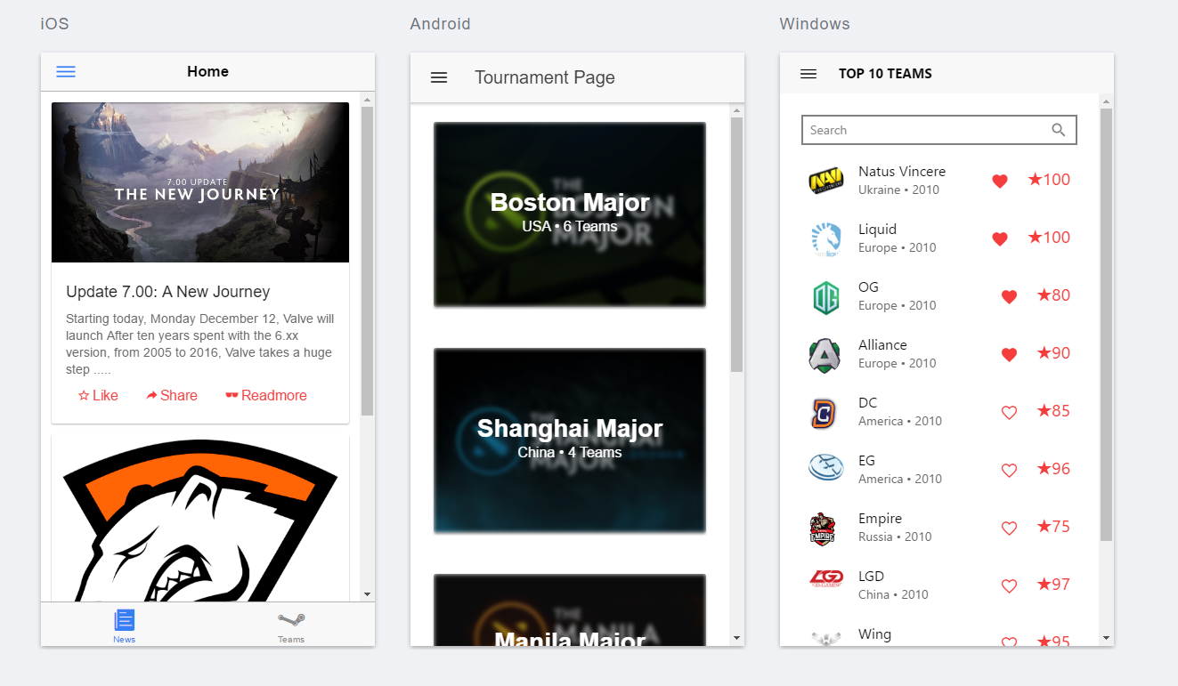
Screen SHot

Slide 6
Overall architecture
News
Followed Teams
Side Menu
New Detail
Home
Tournament
Tournaments
Description
Teams Involve
Team Detail
Top 10 Teams
Team

Slide 7
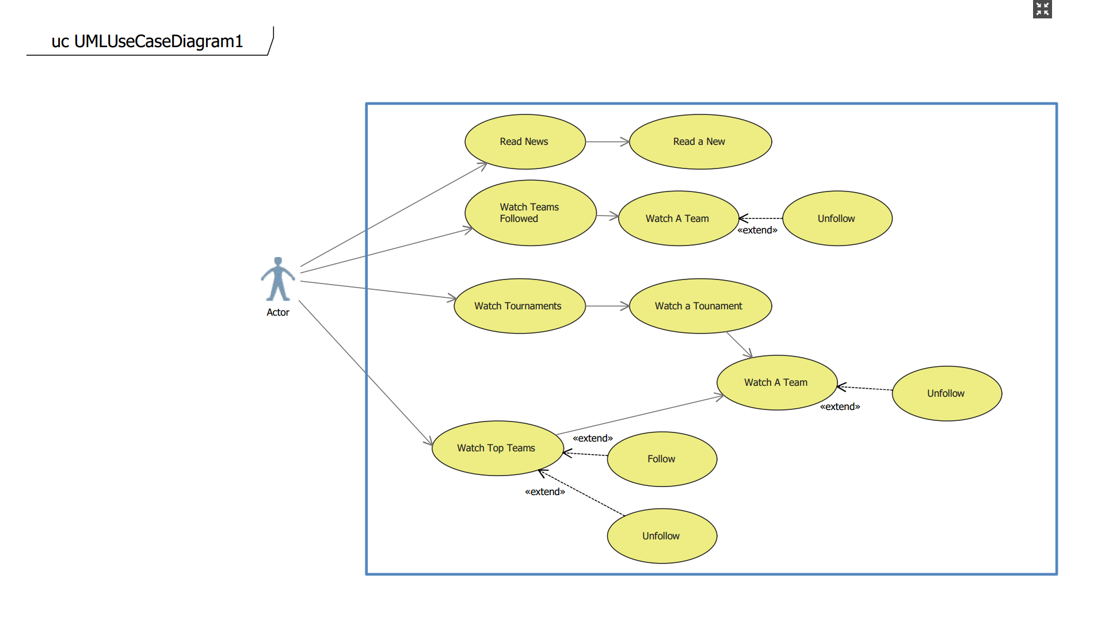
Usecase Diagram​

Slide 8
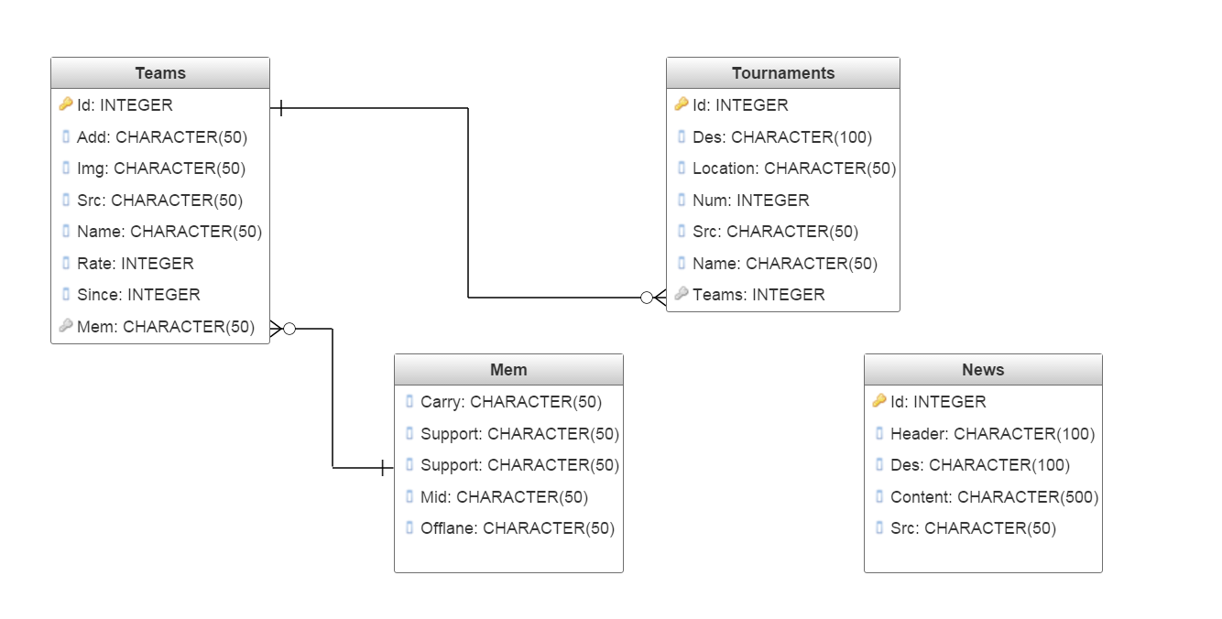
Database

Slide 9
Demo

Slide 10
Q&A

Slide 11
Thanks For Watching!

